Slide 1

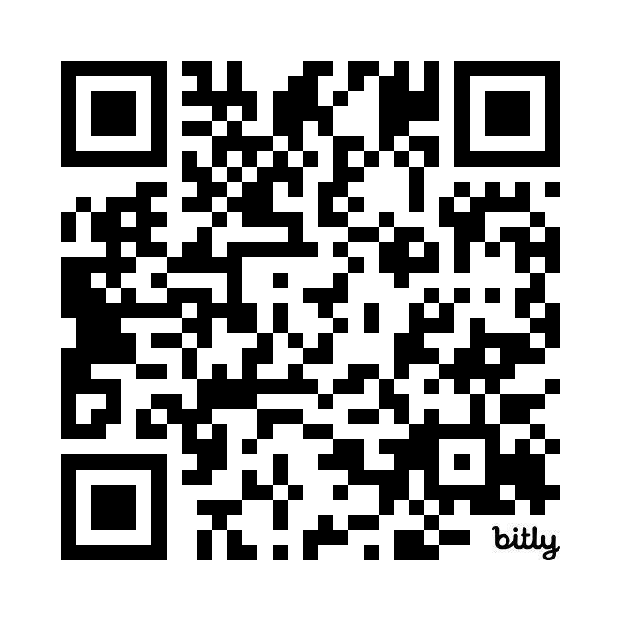

Scan the QR code to submit session evaluations.

Slide 2






















SQL Saturday Baton Rouge 2024
Thank you, Sponsors!

